Slide 1
web app service
azure web app is a cloud computing based platform for hosting websites
Created by the Microsoft . It is a platform as a service which allow publishing web apps running on multiple frame works and written in different programming languages .

Slide 2
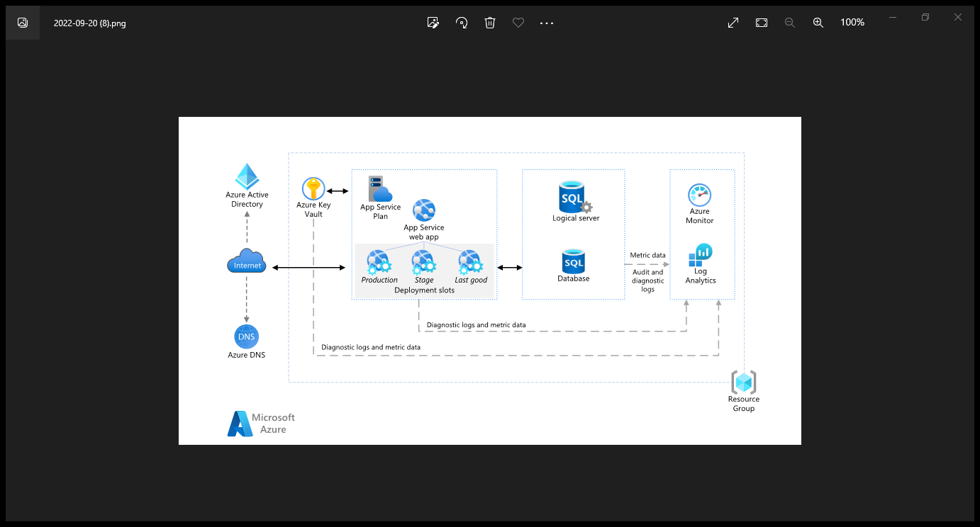

Slide 3
FEATURRES OF AZURE WEB APPS
AZURE WEB APPS ARE EASIEST WAY TO DEPLOY APPS TO THE CLOUD
COMBINE MULTIPLE APPS TO SAVE MONEY
AUTOMATIC HIGH AVAILABILITYAND AUTO SCALING
LOW COST
SECURITY
DEPLOYMENT SLOTS
NO SERVER MAINTENANCE

Slide 4
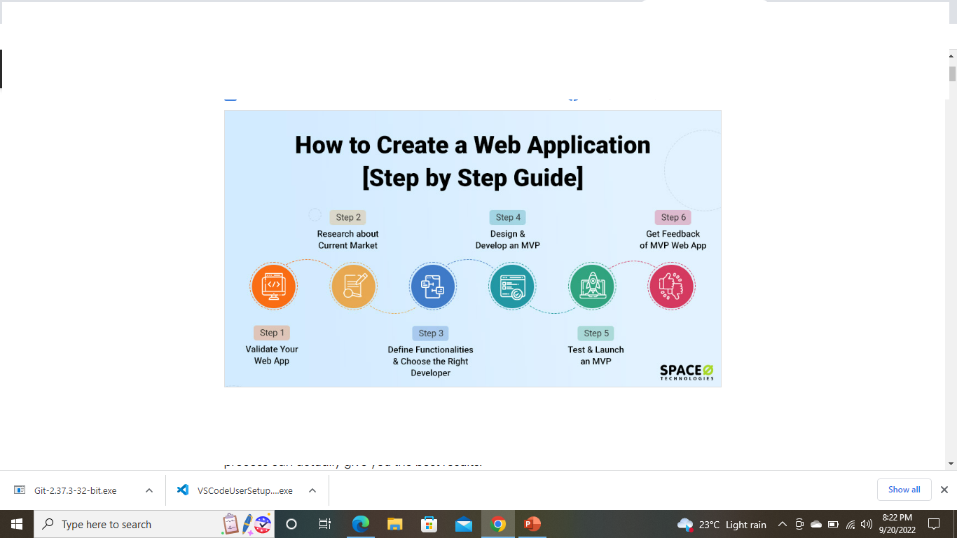
CREATION OF WEB APPS

Slide 5
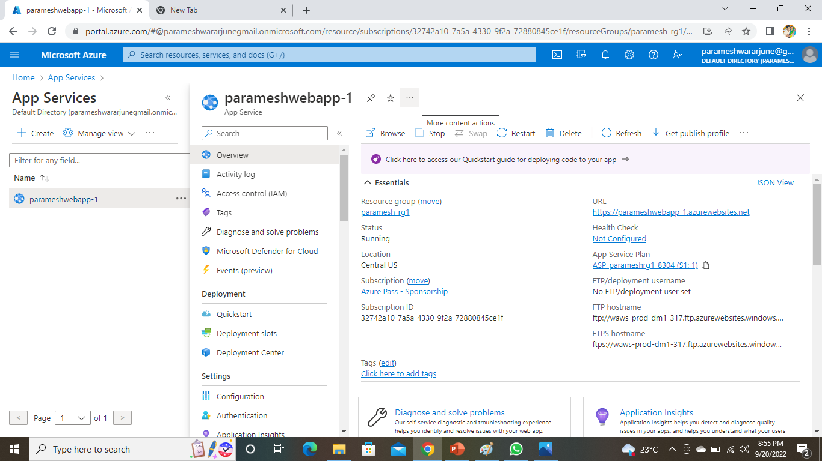

Slide 6
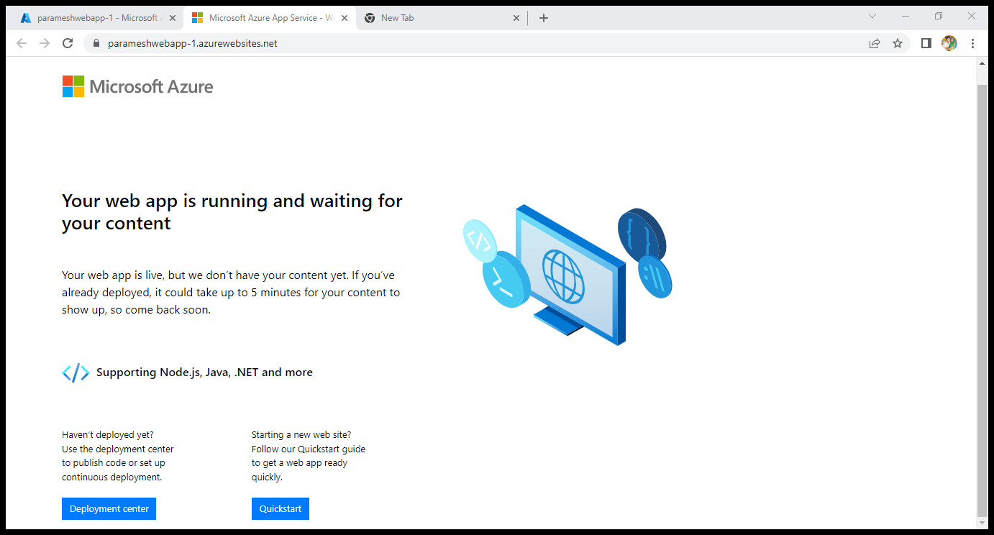
output

Slide 7
Storage account
Azure storage account contains all of your azure storage data objects ,
Including blobs, file shares , queues, tables and disks. The storage accoutprovides a unique namespace for your azure storage data that’s accessible fromanywhere in the world over HTTP or HTTPS.
TYPES OF AZURE STORAGE :-
Blobs ,files , queues, tables and disks
Cloud-based
Durable
Highly available
Scalable
Managed
Accessible

Slide 8
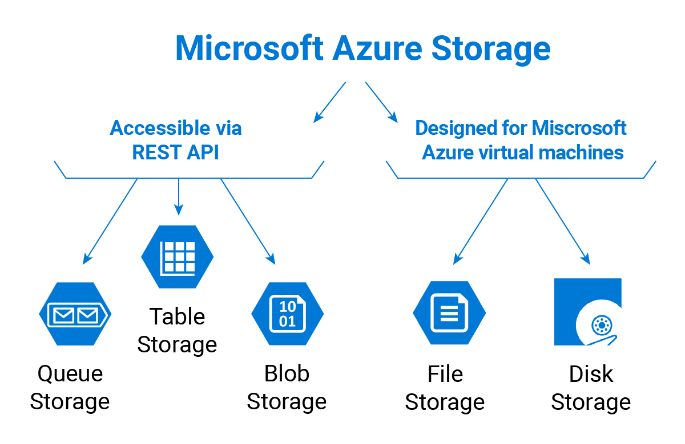

Slide 9
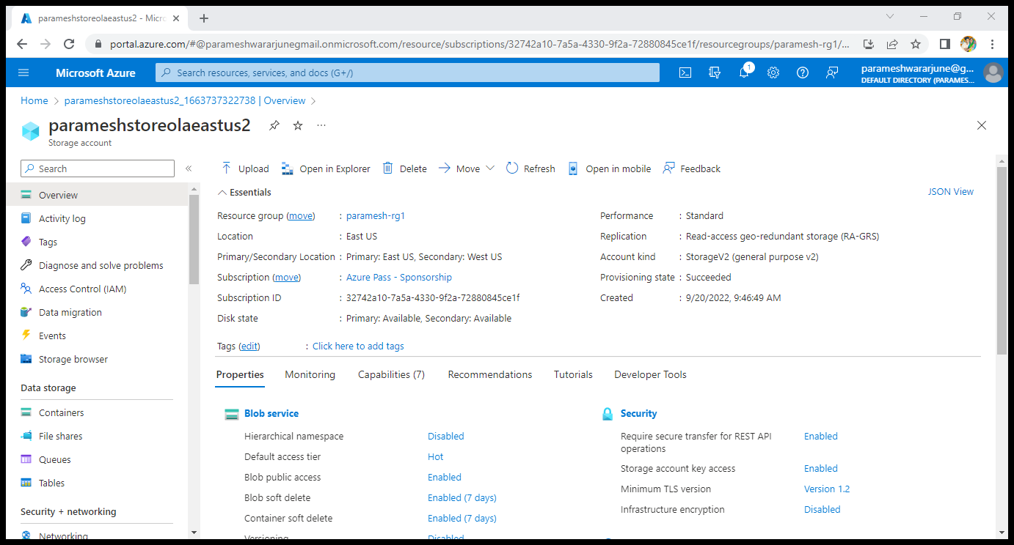
Creation of storage account

